Slide 1
Hospital Management System Final Project by Jayesh Patil
NuiD :- 001475648

Slide 2
PROBLEM STATEMENT
Hospitals are always busy, and they generate and store lots of data on a daily basis of different patients, doctors, employee, pharmacy, laboratory, billing, staff, bed allocation, etc. Our goal is to design an efficient database management system for hospitals to store their data on daily basis. The Hospital contains data records which include patients, treatment & Medical history.

Slide 3
Solution
So, to overcome this problem , this proposed database system would do the needful.
The system provides all the necessary connections required for a Hospital Management System

Slide 4
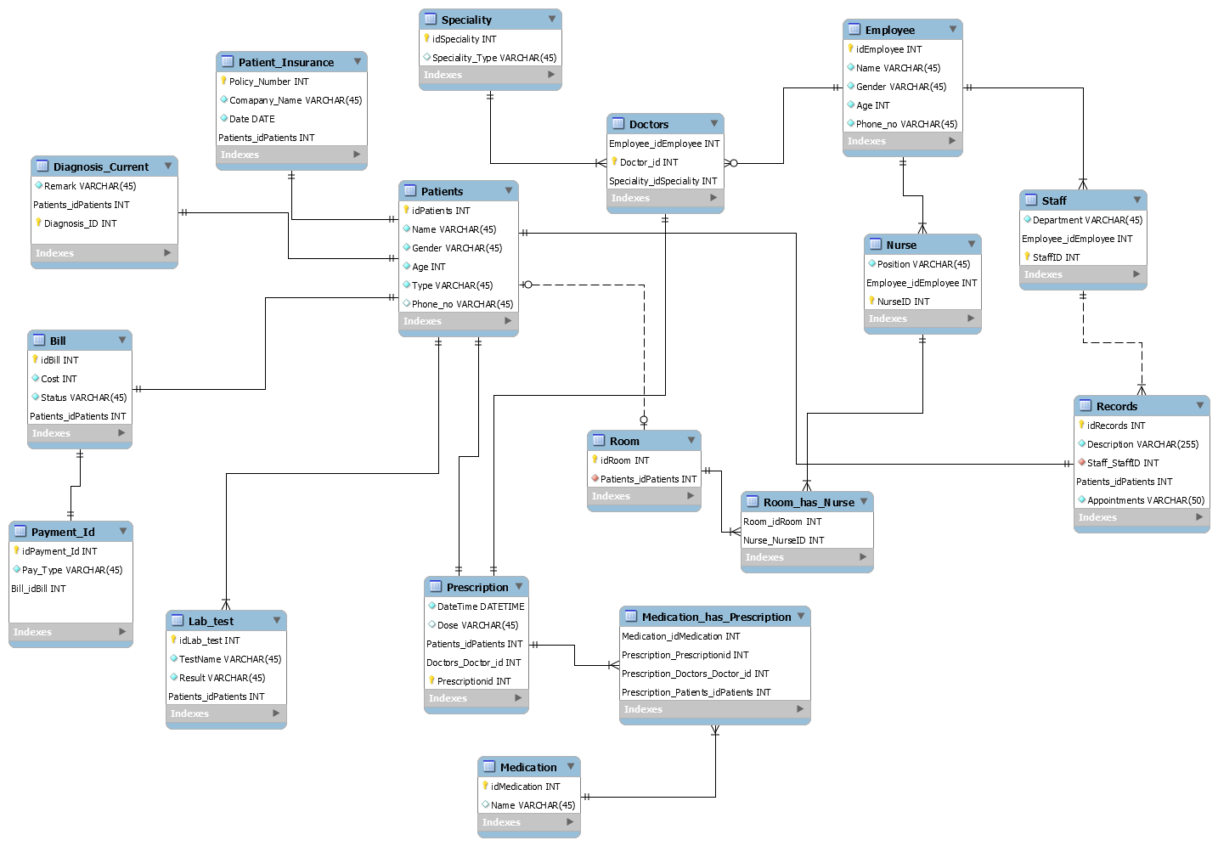
E-R diagram

Slide 5
The project covers : -
3NF Normalization
Joins
Subqueries
Triggers
Views
Procedures
Index

Slide 6
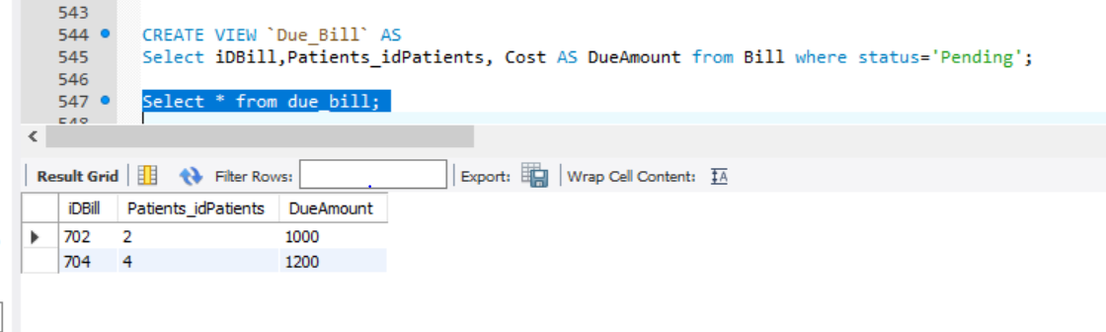
Views:

Slide 7
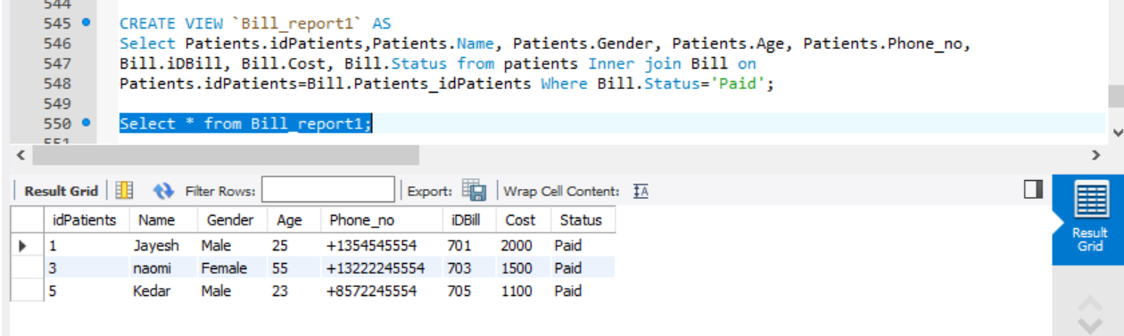
Views:

Slide 8
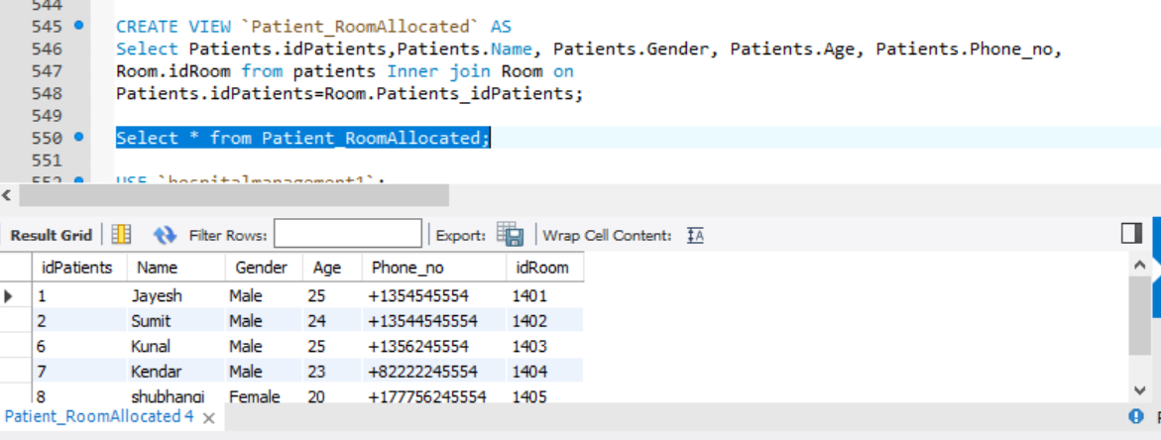
Views:

Slide 9
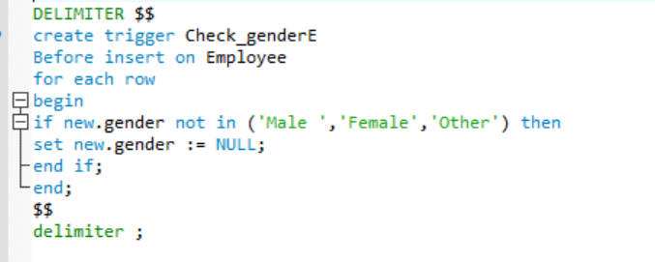
Triggers-

Slide 10
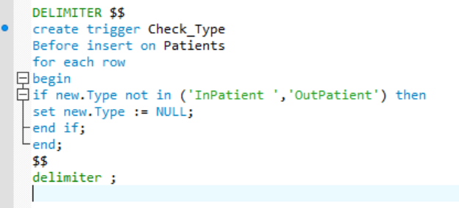
Triggers

Slide 11
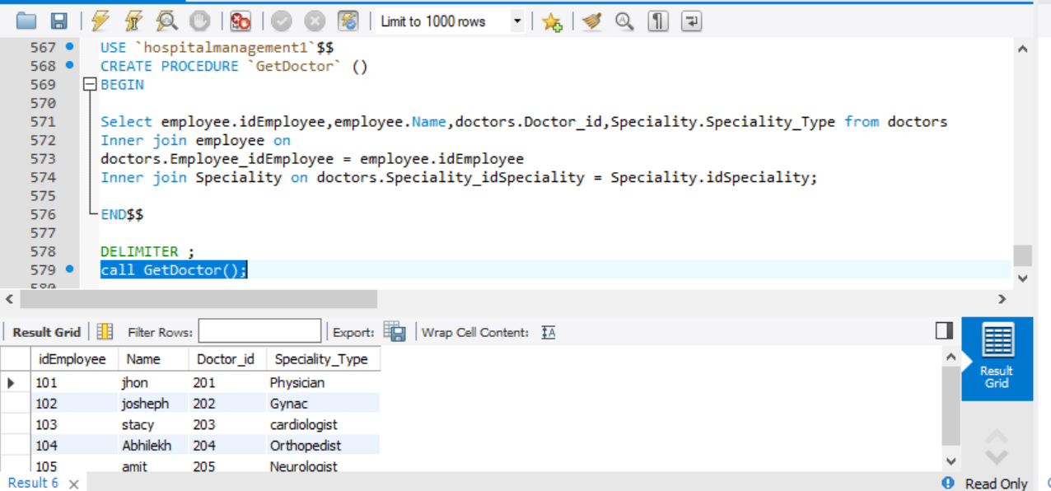
Procedures: With joins of Three tables

Slide 12
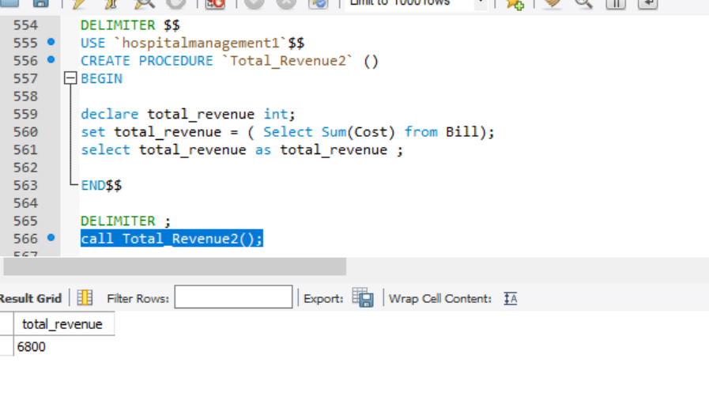
Procedures:

Slide 13
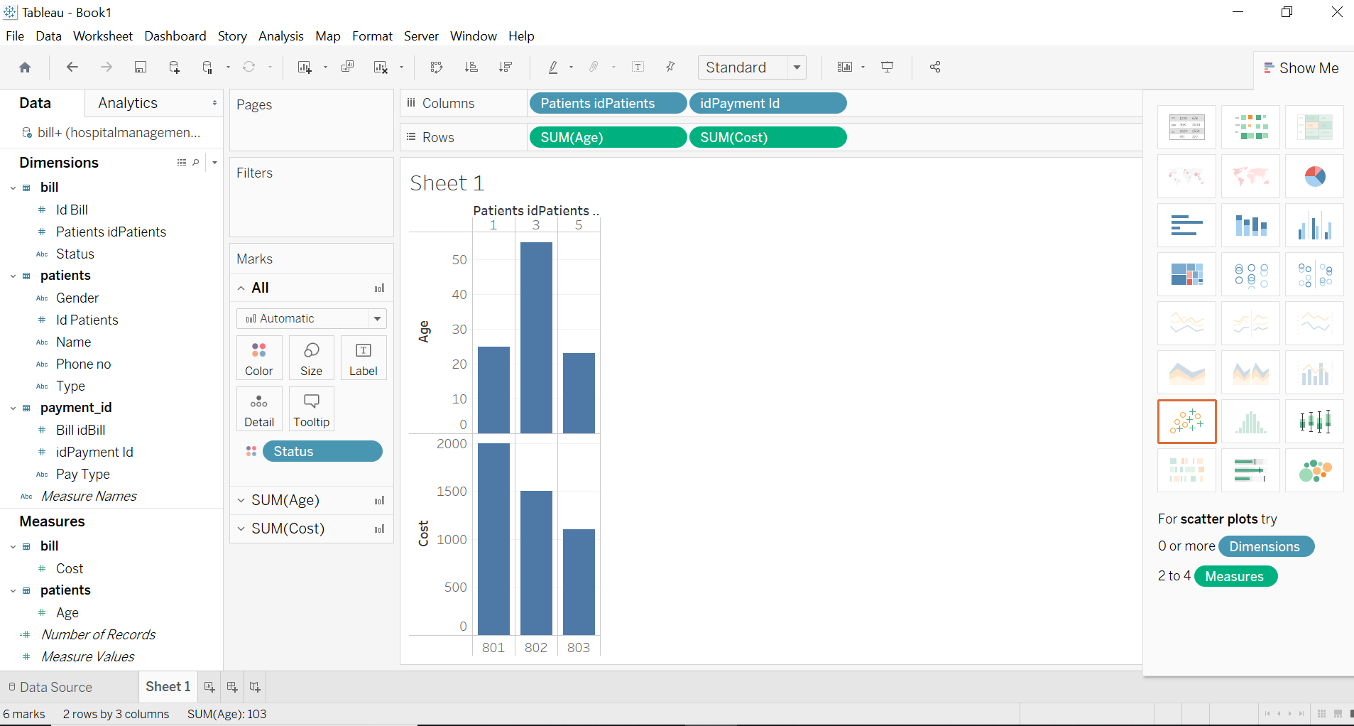
Graph of patients-Bill-Payment Type

